Slide 1

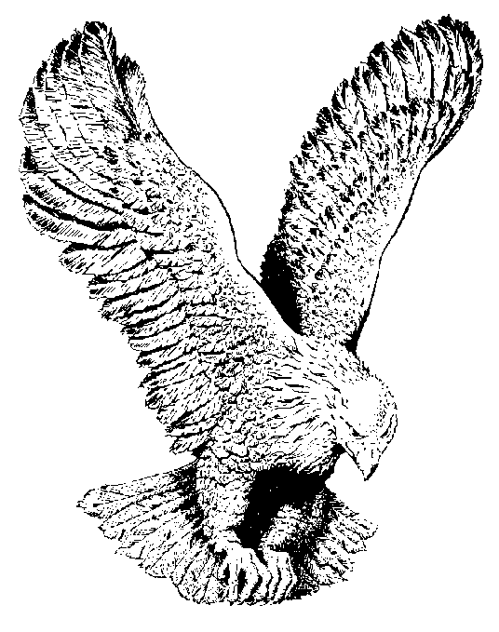
WE’LL NOT LEAVE OUR …
We’ll not leave our little ones behind.
For our Father has them in mind.
Some are weak and some are feeble,
Others feel that they’re not able
We’ll not leave a single one behind.

